Slide 1
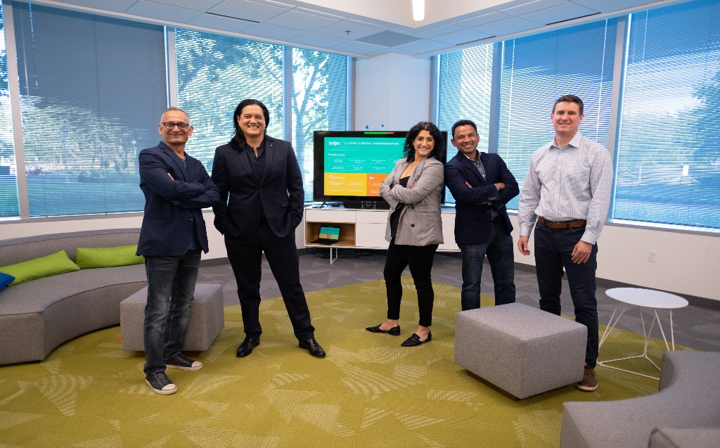


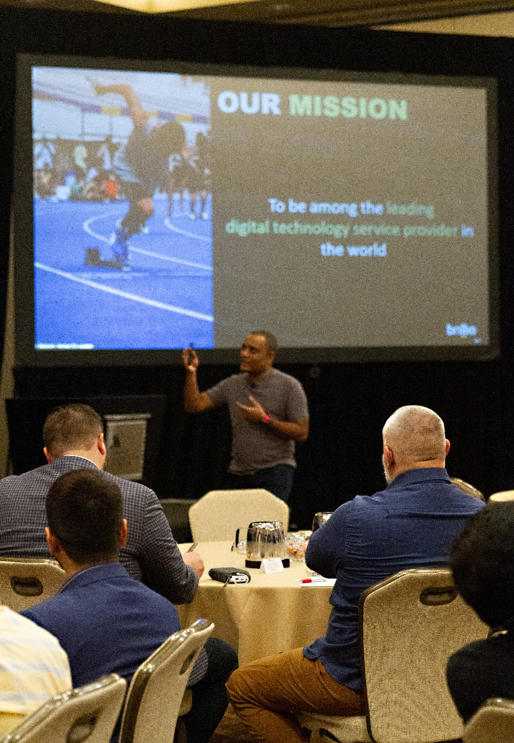

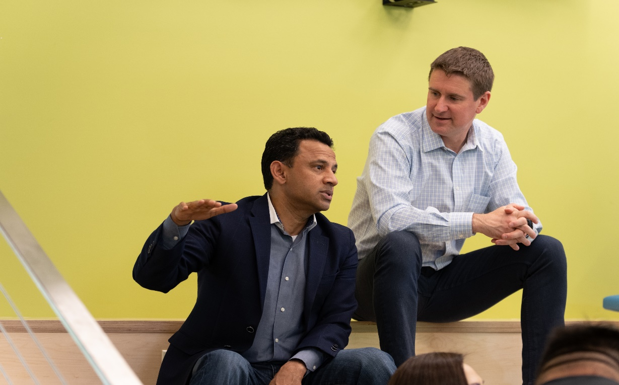
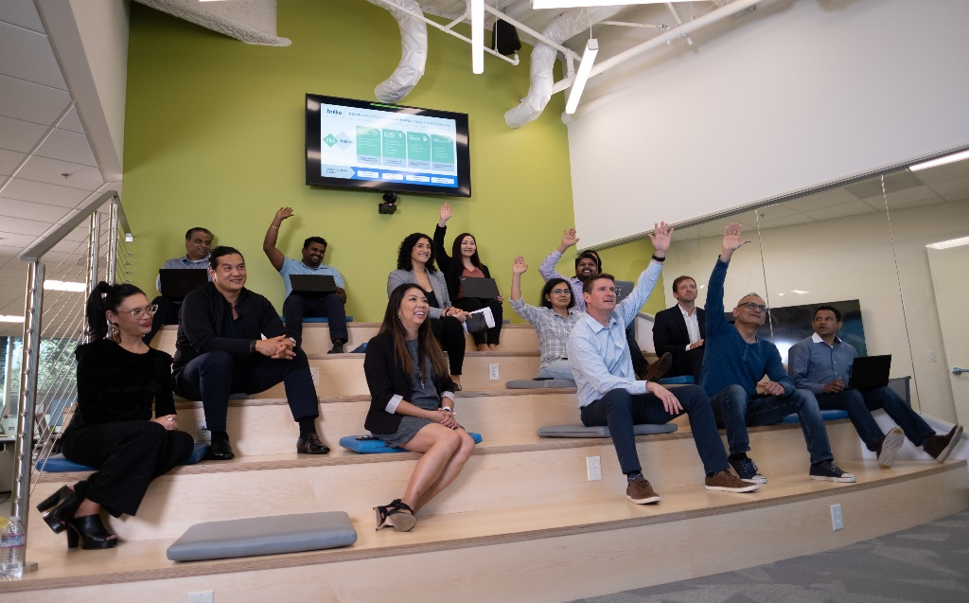

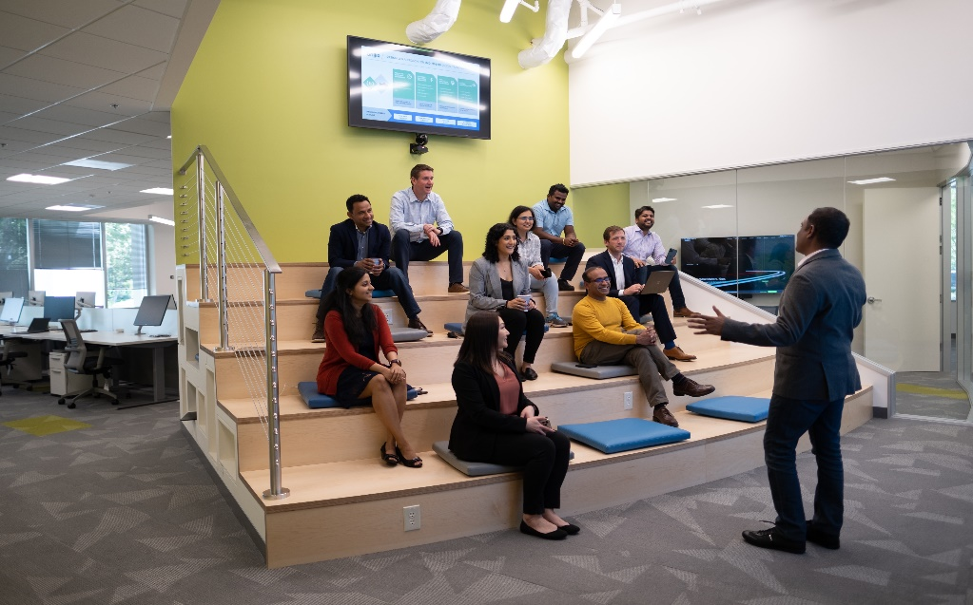



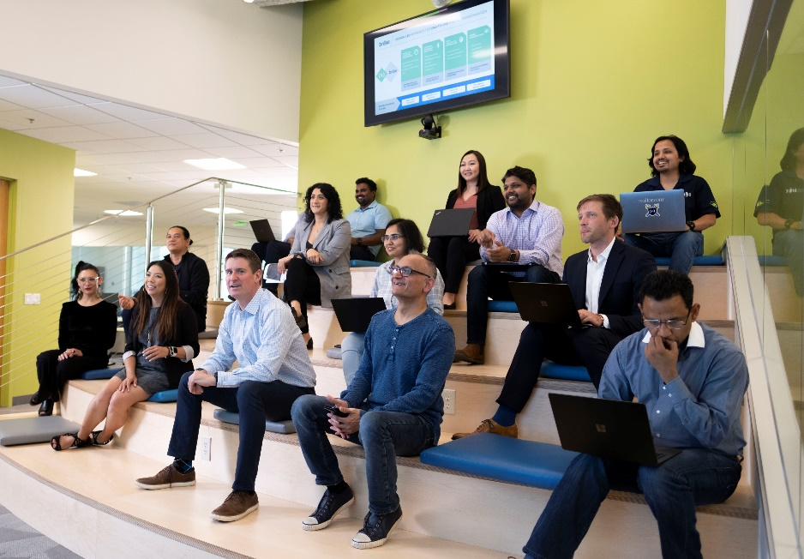

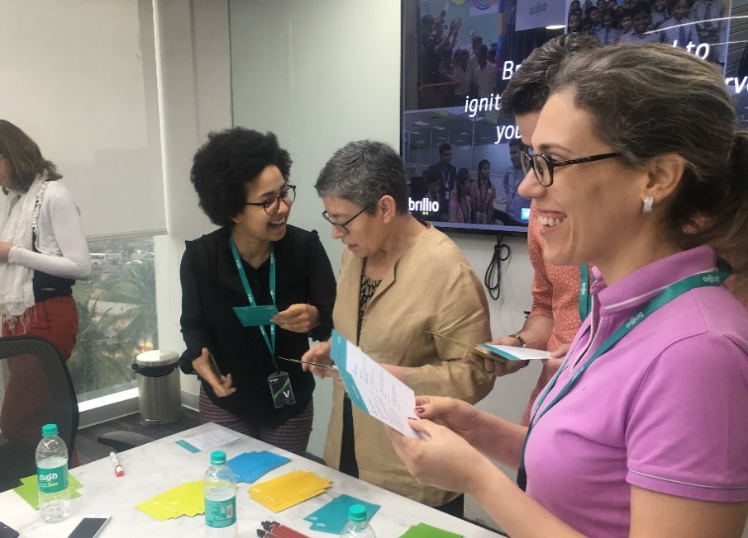
v
Infrasoft Technologies
CAPSTONE PROJECT
(DIGITAL ANALYTICS)
August 2021
ACCELERATE WHAT MATTERS. NOW.

Slide 2


PROBLEM STATEMENT
Infrasoft’s digital head is under tremendous pressure because he just realized that the web site performance has deteriorated in the recent past. He is looking to you as the lead analyst to understand what exactly the issue is and make data backed recommendations on what actions need to be taken to prevent further losses that the business is undergoing.
PART 1- ANALYSIS
Create a segment to identify new visitors in a particular time-period.
How many customers abandoned the cart and purchase any product within 2 weeks of abandoning the cart?
How many users reached to the cart review page after adding the product into the bag and visited at least one page in between?
How many visitors (monthly trended view) purchased from the site during Jan – oct’20 and again made a purchase in the holiday season (Nov – dec’20).
How many visitors have placed order for the first time on site in sep’21?
Visits where a user followed the path homepage →product page→ cart page but did not place an order.
PART 2 - SEGMENTATION

Slide 3
METHODOLOGY
Daily – Web Metrics
Product Performance
Marketing Channel Performance
Sie Section Performance
Integration
Assess
Month on Month Performance –Page Visits, Orders and Revenue
Product Performance – Page Visits, Orders and Revenue
Orders
Revenue
Page Visits
Conversion Rate
Key KPIs

Slide 4
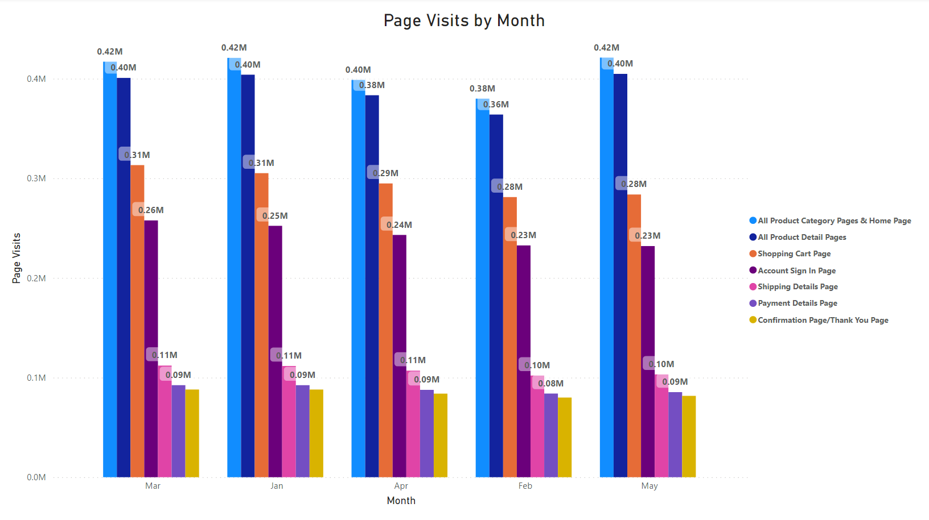
ANALYSIS - 1
KEY FINDINGS
Decrease in Number of Page Visits from Sign In Page -> Shopping Details Page
HYPOTHESIS
New Customers when ordering for the first time prefer Guest Checkout than Creating a new Account
IMPROVISATIONS
Add Guest Checkout Feature

Slide 5
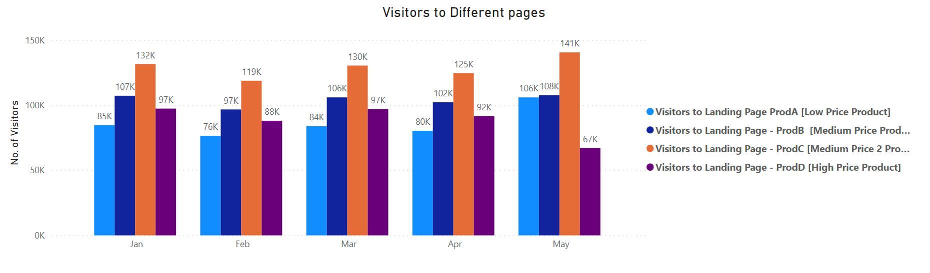
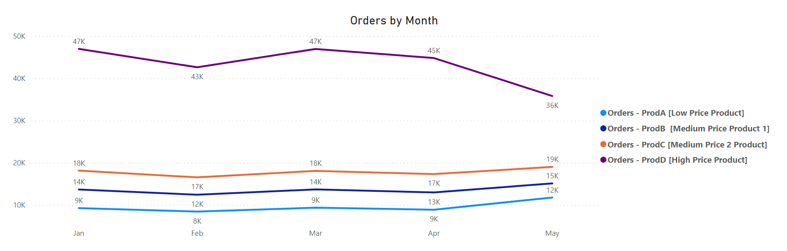
ANALYSIS - 2
KEY FINDINGS
Product C has highest Page Visits but less orders
HYPOTHESIS
Customers are Visiting Product C page first, but they are diverting to Prod D from Suggested/Similar Products section because Customers think that Higher cost products have better quality.
IMPROVISATIONS
Improve Quality of Product A,B & C

Slide 6
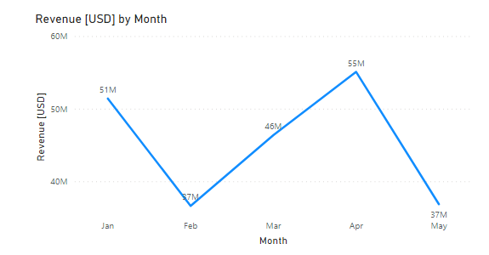
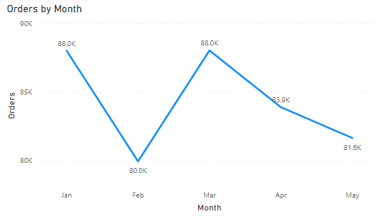
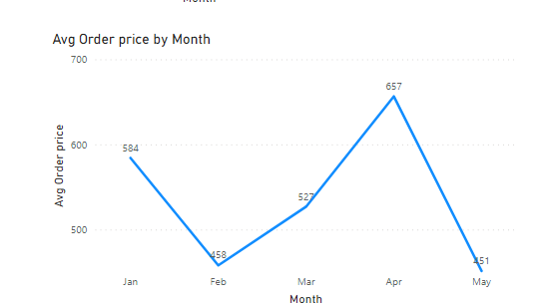
ANALYSIS - 3
KEY FINDINGS
HYPOTHESIS
IMPROVISATIONS
Revenue for the month of April is High even when the orders of the same month is less compared to other months
Average Order Price has Increased which in-turn increased the revenue
Focus on Selling High Price Products

Slide 7
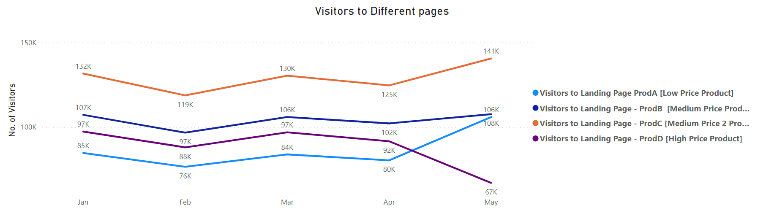
ANALYSIS - 4
KEY FINDINGS
Overall Revenue is dependent on a single product Sales
HYPOTHESIS
Product D has a significant impact on revenue.
IMPROVISATIONS
Focus on sales of all products

Slide 8
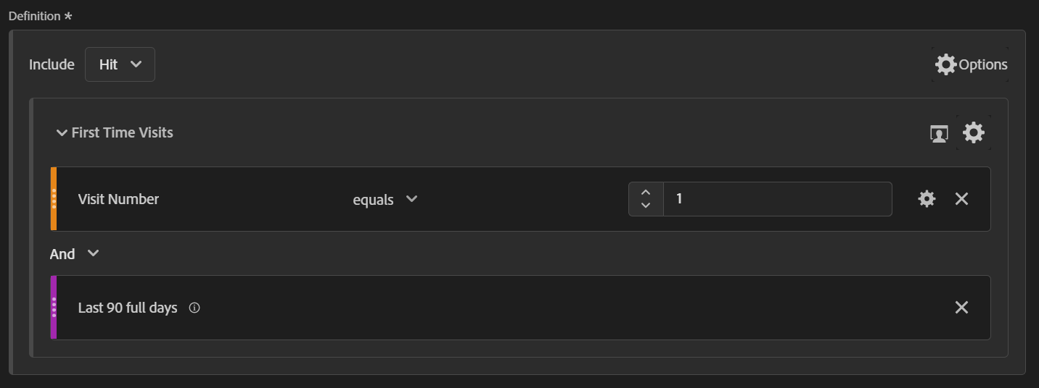
Segment – 1
(Create a segment to identify new visitors in a particular time-period.)

Slide 9
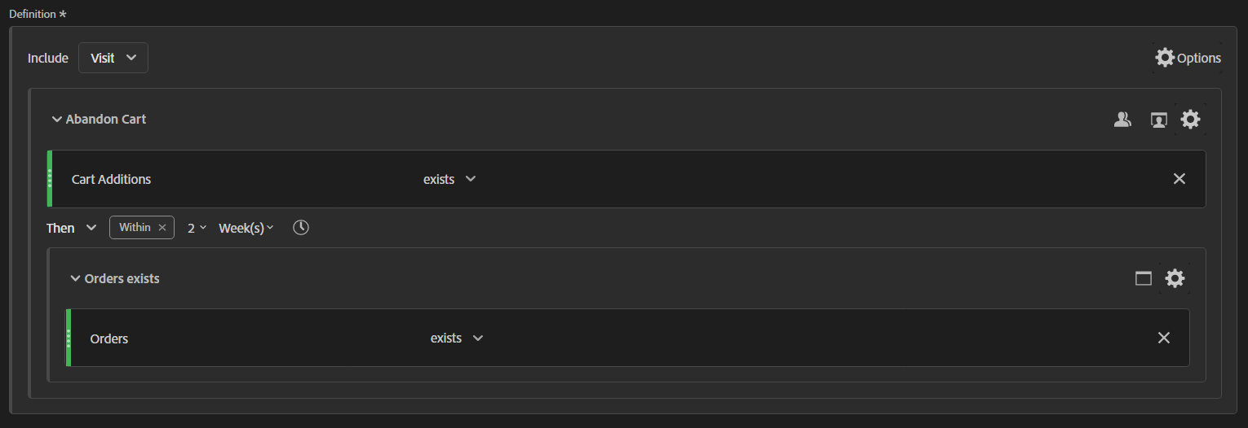
Segment – 2
(How many customers abandoned the cart and purchase any product within 2 weeks of abandoning the cart?)

Slide 10
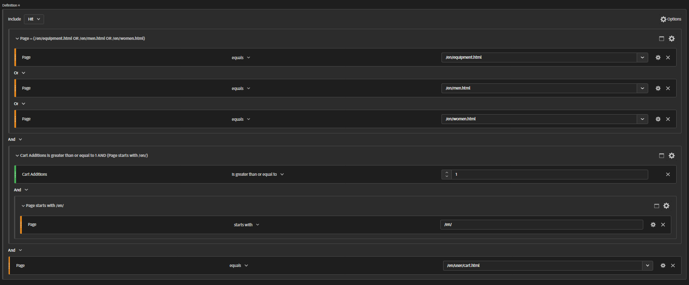
Segment – 3
(How many users reached to the cart review page after adding the product into the bag and visited at least one page in between?)

Slide 11
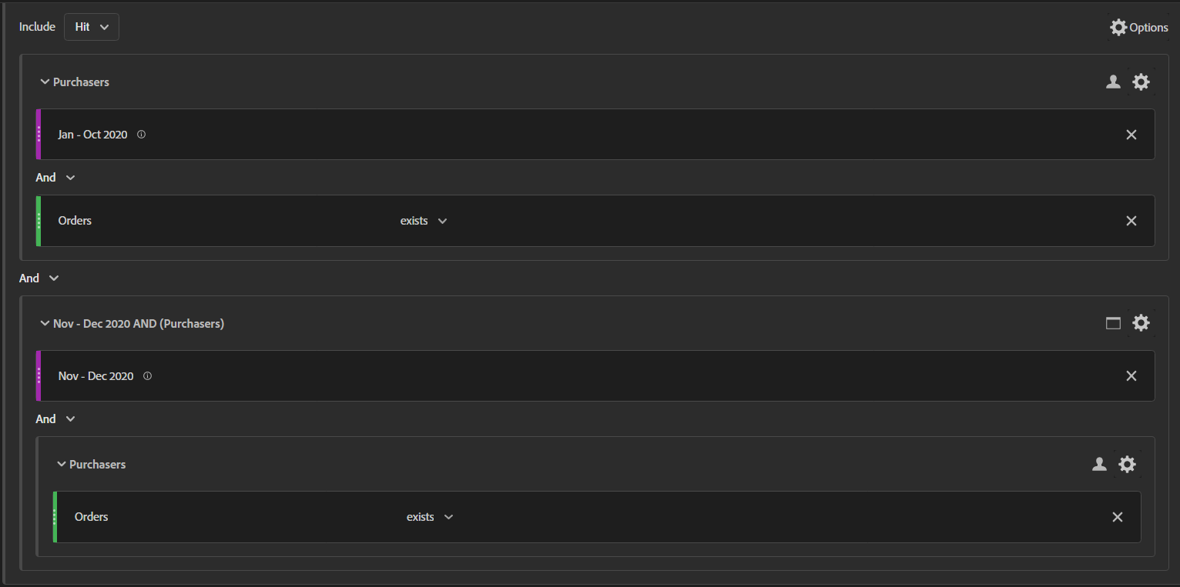
Segment – 4
(How many visitors (monthly trended view) purchased from the site during Jan – oct’20 and again made a purchase in the holiday season (Nov – dec’20).

Slide 12
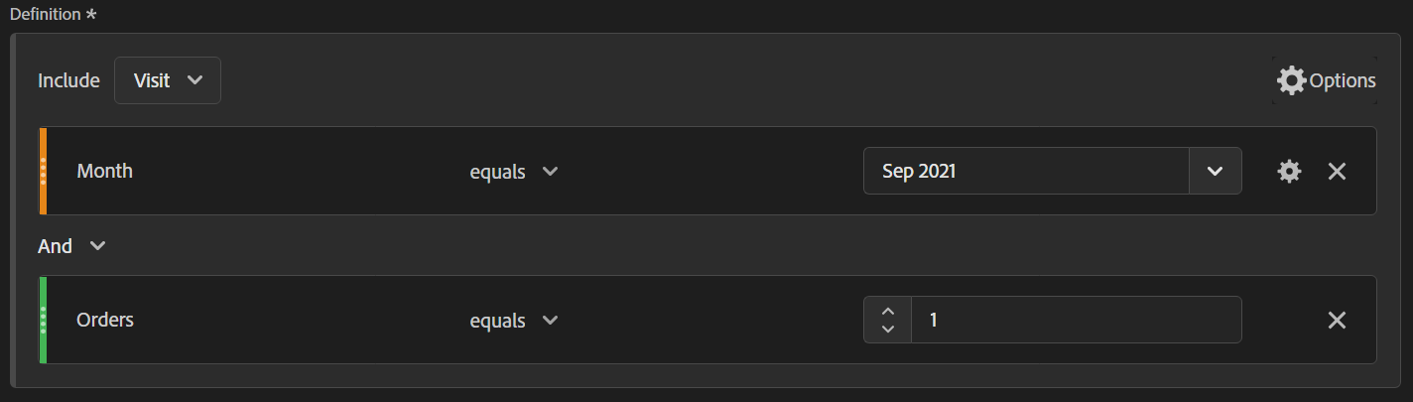
Segment – 5
(How many visitors have placed order for the first time on site in sep’21?)

Slide 13
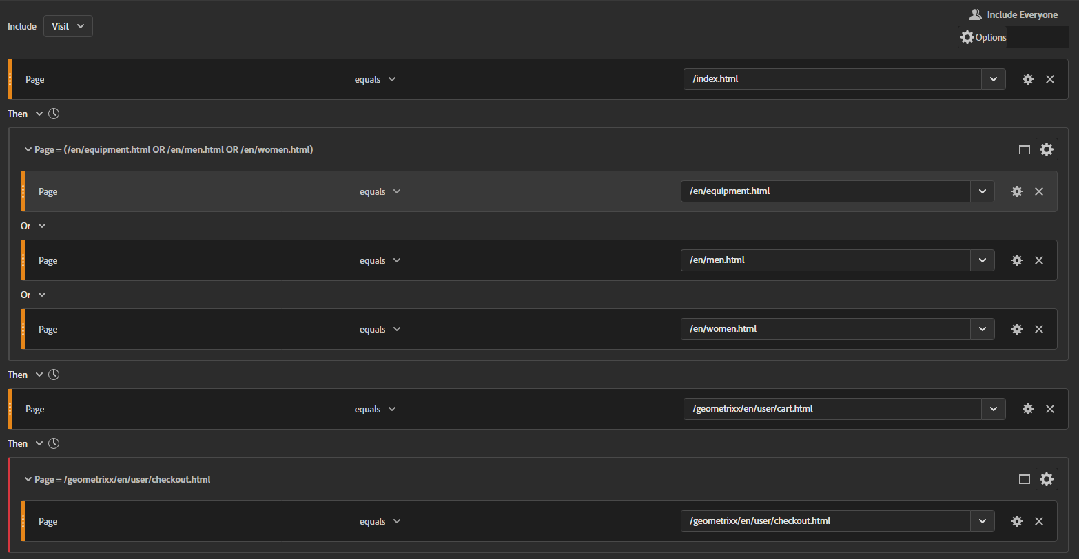
Segment – 6
(Visits where a user followed the path homepage →product page→ cart page but did not place an order.)

Slide 14
THANK YOU
Team – 5:
Lokesh B M
Chennakeshava NT
LET’S BUILD SOMETHING
AMAZING TOGETHER…
© 2021 BRILLIO TECHNOLOGIES

